Slide 1


Data-Intensive Computing with MapReduce
Session 11: Beyond MapReduce
Jimmy Lin
University of Maryland
Thursday, April 11, 2013
This work is licensed under a Creative Commons Attribution-Noncommercial-Share Alike 3.0 United States See http://creativecommons.org/licenses/by-nc-sa/3.0/us/ for details

Slide 2
Today’s Agenda
Making Hadoop more efficient
Tweaking the MapReduce programming model
Beyond MapReduce

Slide 3
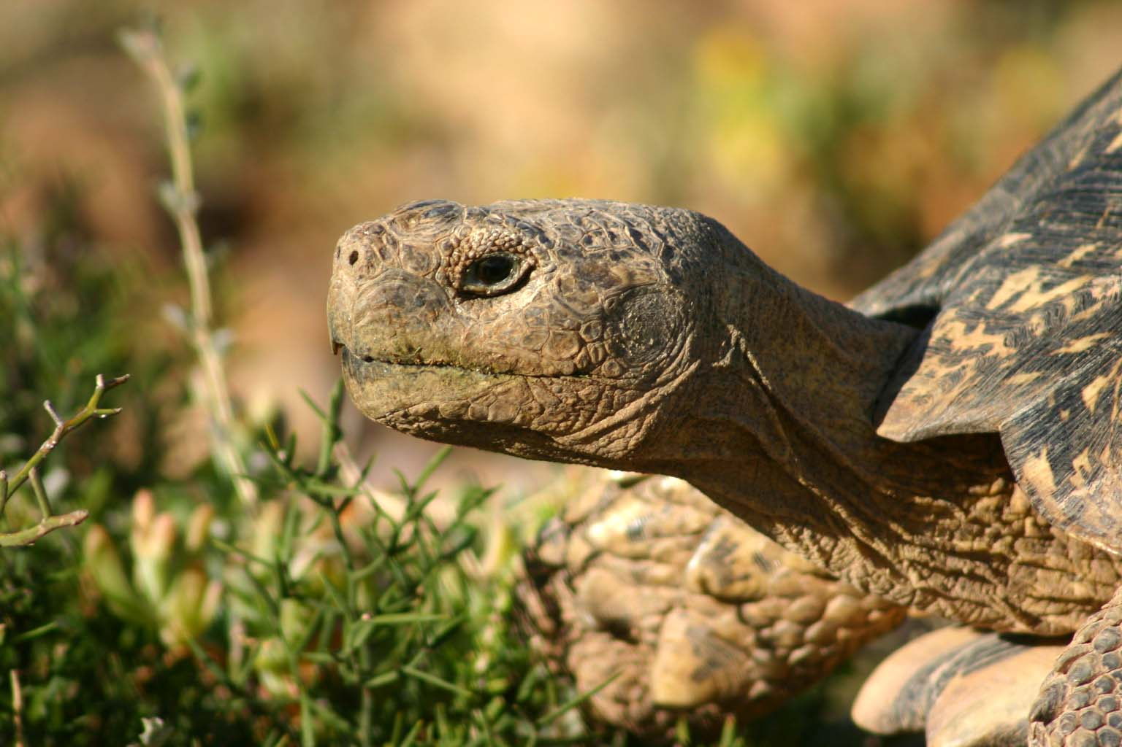
Hadoop is slow...
Source: Wikipedia (Tortoise)

Slide 4
A Major Step Backwards?
MapReduce is a step backward in database access:
Schemas are good
Separation of the schema from the application is good
High-level access languages are good
MapReduce is poor implementation
Brute force and only brute force (no indexes, for example)
MapReduce is not novel
MapReduce is missing features
Bulk loader, indexing, updates, transactions…
MapReduce is incompatible with DMBS tools
Source: Blog post by DeWitt and Stonebraker

Slide 5
Hadoop vs. Databases: Grep
SELECT * FROM Data WHERE field LIKE ‘%XYZ%’;
Source: Pavlo et al. (2009) A Comparison of Approaches to Large-Scale Data Analysis. SIGMOD.

Slide 6
Hadoop vs. Databases: Select
SELECT pageURL, pageRank
FROM Rankings WHERE pageRank > X;
Source: Pavlo et al. (2009) A Comparison of Approaches to Large-Scale Data Analysis. SIGMOD.

Slide 7
Hadoop vs. Databases: Aggregation
SELECT sourceIP, SUM(adRevenue)
FROM UserVisits GROUP BY sourceIP;
Source: Pavlo et al. (2009) A Comparison of Approaches to Large-Scale Data Analysis. SIGMOD.

Slide 8
Hadoop vs. Databases: Join
Source: Pavlo et al. (2009) A Comparison of Approaches to Large-Scale Data Analysis. SIGMOD.

Slide 9
Why?
Source: Wikipedia (Tortoise)

Slide 10
Schemas are a good idea!
Parsing fields out of flat text files is slow
Schemas define a contract, decoupling logical from physical

Slide 11
Thrift
Originally developed by Facebook, now an Apache project
Provides a DDL with numerous language bindings
Compact binary encoding of typed structs
Fields can be marked as optional or required
Compiler automatically generates code for manipulating messages
Provides RPC mechanisms for service definitions
Alternatives include protobufs and Avro

Slide 12
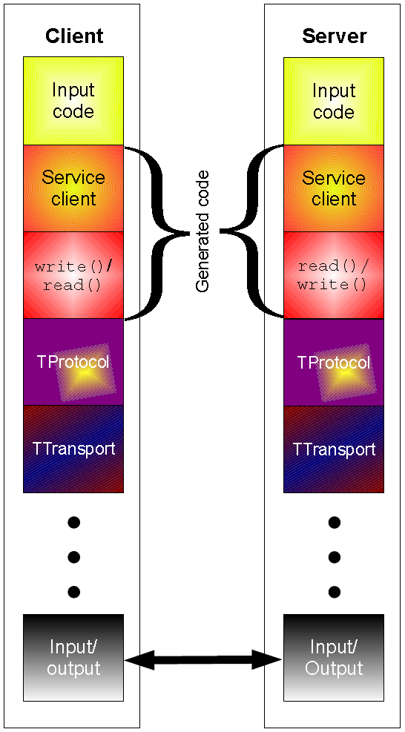
Thrift
struct Tweet {
1: required i32 userId;
2: required string userName;
3: required string text;
4: optional Location loc;
}
struct Location {
1: required double latitude;
2: required double longitude;
}

Slide 13
Row vs. Column Stores
R₁
R₂
R₃
R₄
Row store
Column store

Slide 14
Row vs. Column Stores
Row stores
Easy to modify a record
Might read unnecessary data when processing
Column stores
Only read necessary data when processing
Tuple writes require multiple accesses

Slide 15
OLTP/OLAP Architecture
OLTP
OLAP
ETL (Extract, Transform, and Load)

Slide 16
Advantages of Column Stores
Read efficiency
Better compression
Vectorized processing
Opportunities to operate directly on compressed data

Slide 17
Why not in Hadoop?
No reason why not
RCFile
Source: He et al. (2011) RCFile: A Fast and Space-Efficient Data Placement Structure in MapReduce-based Warehouse Systems. ICDE.

Slide 18
“Trojan Layouts”
Source: Jindal et al. (2011) Trojan Data Layouts: Right Shoes for a Running Elephant. SoCC.

Slide 19
Key Ideas
Separate logical from physical
Preserve HDFS block structure
Hide physical storage layout behind InputFormats

Slide 20
Hadoop vs. Databases: Grep (Revisited)
SELECT * FROM Data WHERE field LIKE ‘%XYZ%’;
Source: Pavlo et al. (2009) A Comparison of Approaches to Large-Scale Data Analysis. SIGMOD.

Slide 21
Hadoop vs. Databases: Select (Revisited)
SELECT pageURL, pageRank
FROM Rankings WHERE pageRank > X;
Source: Pavlo et al. (2009) A Comparison of Approaches to Large-Scale Data Analysis. SIGMOD.

Slide 22

Indexes are a good thing!
Source: Wikipedia (Card Catalog)

Slide 23

Why not in Hadoop?
No reason why not
Non-invasive: requires no changes to Hadoop infrastructure
Useful for speeding up selections on joins
Indexing building itself can be performed using MapReduce
Source: Dittrich et al. (2010) Hadoop++: Making a Yellow Elephant Run Like a Cheetah (Without It Even Noticing). VLDB.

Slide 24
A Major Step Backwards?
MapReduce is a step backward in database access:
Schemas are good
Separation of the schema from the application is good
High-level access languages are good
MapReduce is poor implementation
Brute force and only brute force (no indexes, for example)
MapReduce is not novel
MapReduce is missing features
Bulk loader, indexing, updates, transactions…
MapReduce is incompatible with DMBS tools
✔
✔
?
✔
?
Source: Blog post by DeWitt and Stonebraker

Slide 25
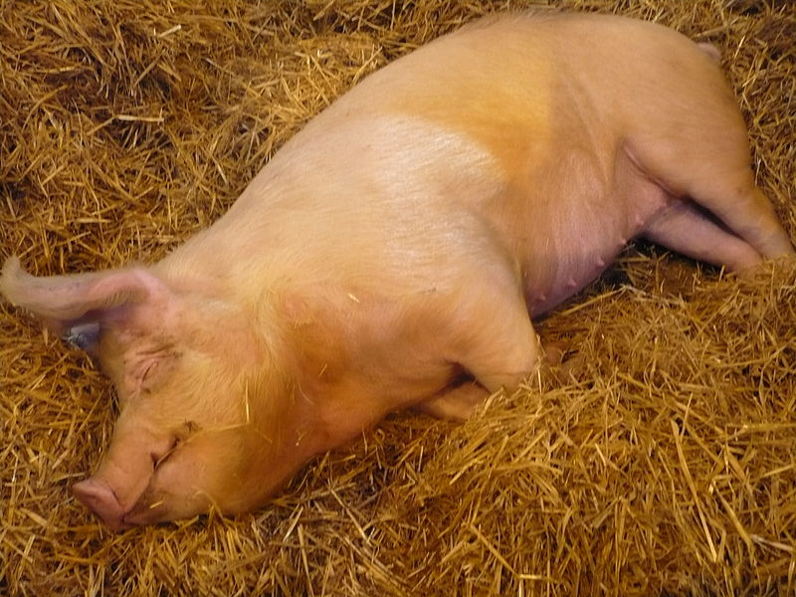
Pig!
Source: Wikipedia (Pig)

Slide 26
Pig: Example
Task: Find the top 10 most visited pages in each category
Visits
Url Info
User | Url | Time
Amy | cnn.com | 8:00
Amy | bbc.com | 10:00
Amy | flickr.com | 10:05
Fred | cnn.com | 12:00
Url | Category | PageRank
cnn.com | News | 0.9
bbc.com | News | 0.8
flickr.com | Photos | 0.7
espn.com | Sports | 0.9
Pig Slides adapted from Olston et al. (SIGMOD 2008)

Slide 27
Pig Query Plan
Load Visits
Group by url
Foreach url
generate count
Load Url Info
Join on url
Group by category
Foreach category
generate top10(urls)
Pig Slides adapted from Olston et al. (SIGMOD 2008)

Slide 28
Pig Script
visits = load ‘/data/visits’ as (user, url, time);
gVisits = group visits by url;
visitCounts = foreach gVisits generate url, count(visits);
urlInfo = load ‘/data/urlInfo’ as (url, category, pRank);
visitCounts = join visitCounts by url, urlInfo by url;
gCategories = group visitCounts by category;
topUrls = foreach gCategories generate top(visitCounts,10);
store topUrls into ‘/data/topUrls’;
Pig Slides adapted from Olston et al. (SIGMOD 2008)

Slide 29
Pig Script in Hadoop
Map₁
Load Visits
Group by url
Reduce₁
Map₂
Foreach url
generate count
Load Url Info
Join on url
Reduce₂
Map₃
Group by category
Reduce₃
Foreach category
generate top10(urls)
Pig Slides adapted from Olston et al. (SIGMOD 2008)

Slide 30
Pig: Basics
Sequence of statements manipulating relations (aliases)
Data model
atoms
tuples
bags
maps
json

Slide 31
Pig: Common Operations
LOAD: load data
FOREACH … GENERATE: per tuple processing
FILTER: discard unwanted tuples
GROUP/COGROUP: group tuples
JOIN: relational join

Slide 32
Pig: GROUPing
A = LOAD 'myfile.txt' USING PigStorage('\t') AS (f1,f2,f3);
(1, 2, 3)
(4, 2, 1)
(8, 3, 4)
(4, 3, 3)
(7, 2, 5)
(8, 4, 3)
X = GROUP A BY f1;
(1, {(1, 2, 3)})
(4, {(4, 2, 1), (4, 3, 3)})
(7, {(7, 2, 5)})
(8, {(8, 3, 4), (8, 4, 3)})

Slide 33
Pig: COGROUPing
A:
(1, 2, 3)
(4, 2, 1)
(8, 3, 4)
(4, 3, 3)
(7, 2, 5)
(8, 4, 3)
B:
(2, 4)
(8, 9)
(1, 3)
(2, 7)
(2, 9)
(4, 6)
(4, 9)
X = COGROUP A BY f1, B BY $0;
(1, {(1, 2, 3)}, {(1, 3)})
(2, {}, {(2, 4), (2, 7), (2, 9)})
(4, {(4, 2, 1), (4, 3, 3)}, {(4, 6),(4, 9)})
(7, {(7, 2, 5)}, {})
(8, {(8, 3, 4), (8, 4, 3)}, {(8, 9)})

Slide 34
Pig UDFs
User-defined functions:
Java
Python
JavaScript
Ruby
UDFs make Pig arbitrarily extensible
Express “core” computations in UDFs
Take advantage of Pig as glue code for scale-out plumbing

Slide 35
PageRank in Pig
previous_pagerank = LOAD ‘$docs_in’ USING PigStorage()
AS (url: chararray, pagerank: float,
links:{link: (url: chararray)});
outbound_pagerank = FOREACH previous_pagerank
GENERATE pagerank / COUNT(links) AS pagerank,
FLATTEN(links) AS to_url;
new_pagerank =
FOREACH ( COGROUP outbound_pagerank
BY to_url, previous_pagerank BY url INNER )
GENERATE group AS url,
(1 – $d) + $d * SUM(outbound_pagerank.pagerank) AS pagerank,
FLATTEN(previous_pagerank.links) AS links;
STORE new_pagerank INTO ‘$docs_out’ USING PigStorage();
From: http://techblug.wordpress.com/2011/07/29/pagerank-implementation-in-pig/

Slide 36
Oh, the iterative part too…
#!/usr/bin/python
from org.apache.pig.scripting import *
P = Pig.compile(""" Pig part goes here """)
params = { ‘d’: ‘0.5’, ‘docs_in’: ‘data/pagerank_data_simple’ }
for i in range(10):
out = "out/pagerank_data_" + str(i + 1)
params["docs_out"] = out
Pig.fs("rmr " + out)
stats = P.bind(params).runSingle()
if not stats.isSuccessful():
raise ‘failed’
params["docs_in"] = out
From: http://techblug.wordpress.com/2011/07/29/pagerank-implementation-in-pig/

Slide 37


vs.
Why write MapReduce code in Java ever?

Slide 38

Tweaking Hadoop
Source: Wikipedia (Chisel)

Slide 39
Hadoop + DBs = HadoopDB
Why not have the best of both worlds?
Parallel databases focused on performance
Hadoop focused on scalability, flexibility, fault tolerance
Key ideas:
Co-locate a RDBMS on every slave node
To the extent possible, “push down” operations into the DB
Source: Abouzeid et al. (2009) HadoopDB: An Architectural Hybrid of MapReduce and DBMS Technologies for Analytical Workloads. VLDB.

Slide 40
HadoopDB Architecture
Source: Abouzeid et al. (2009) HadoopDB: An Architectural Hybrid of MapReduce and DBMS Technologies for Analytical Workloads. VLDB.

Slide 41
HadoopDB: Query Plans
SELECT YEAR(saleDate), SUM(revenue)
FROM sales GROUP BY YEAR(saleDate);
Source: Abouzeid et al. (2009) HadoopDB: An Architectural Hybrid of MapReduce and DBMS Technologies for Analytical Workloads. VLDB.

Slide 42
MapReduce Sucks: Iterative Algorithms
Java verbosity
Hadoop task startup time
Stragglers
Needless data shuffling
Checkpointing at each iteration

Slide 43
HaLoop: MapReduce + Iteration
Programming Model
Source: Bu et al. (2010) HaLoop: Efficient Iterative Data Processing on Large Clusters . VLDB.

Slide 44
HaLoop Architecture
Source: Bu et al. (2010) HaLoop: Efficient Iterative Data Processing on Large Clusters . VLDB.

Slide 45
HaLoop: Loop Aware Scheduling
Source: Bu et al. (2010) HaLoop: Efficient Iterative Data Processing on Large Clusters . VLDB.

Slide 46
HaLoop: Optimizations
Loop-aware scheduling
Caching
Reducer input for invariant data
Reducer output speeding up convergence checks
Source: Bu et al. (2010) HaLoop: Efficient Iterative Data Processing on Large Clusters . VLDB.

Slide 47
HaLoop: Performance
Source: Bu et al. (2010) HaLoop: Efficient Iterative Data Processing on Large Clusters . VLDB.

Slide 48
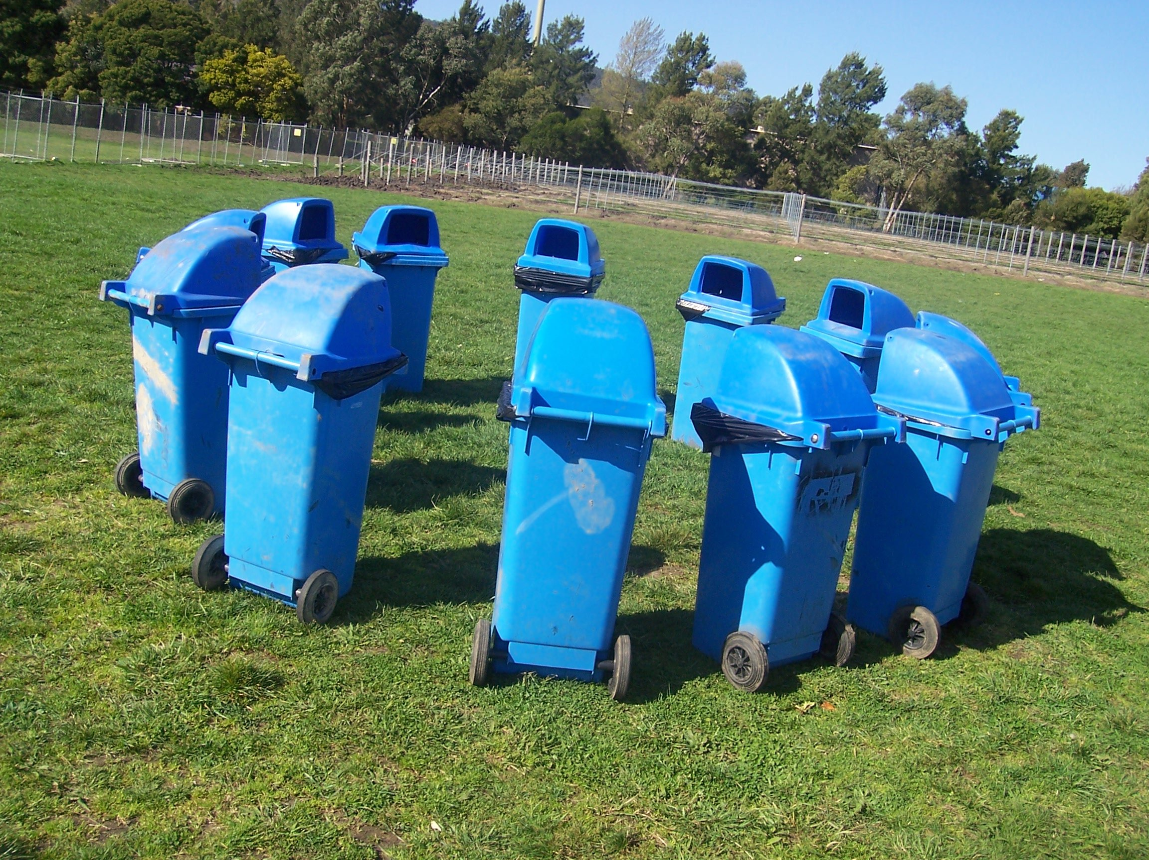
Beyond MapReduce
Source: Wikipedia (Waste container)

Slide 49
Pregel: Computational Model
Based on Bulk Synchronous Parallel (BSP)
Computational units encoded in a directed graph
Computation proceeds in a series of supersteps
Message passing architecture
Each vertex, at each superstep:
Receives messages directed at it from previous superstep
Executes a user-defined function (modifying state)
Emits messages to other vertices (for the next superstep)
Termination:
A vertex can choose to deactivate itself
Is “woken up” if new messages received
Computation halts when all vertices are inactive
Source: Malewicz et al. (2010) Pregel: A System for Large-Scale Graph Processing. SIGMOD.

Slide 50
Pregel
superstep t
superstep t+1
superstep t+2
Source: Malewicz et al. (2010) Pregel: A System for Large-Scale Graph Processing. SIGMOD.

Slide 51
Pregel: Implementation
Master-Slave architecture
Vertices are hash partitioned (by default) and assigned to workers
Everything happens in memory
Processing cycle:
Master tells all workers to advance a single superstep
Worker delivers messages from previous superstep, executing vertex computation
Messages sent asynchronously (in batches)
Worker notifies master of number of active vertices
Fault tolerance
Checkpointing
Heartbeat/revert
Source: Malewicz et al. (2010) Pregel: A System for Large-Scale Graph Processing. SIGMOD.

Slide 52
Pregel: PageRank
class PageRankVertex : public Vertex<double, void, double> {
public:
virtual void Compute(MessageIterator* msgs) {
if (superstep() >= 1) {
double sum = 0;
for (; !msgs->Done(); msgs->Next())
sum += msgs->Value();
*MutableValue() = 0.15 / NumVertices() + 0.85 * sum;
}
if (superstep() < 30) {
const int64 n = GetOutEdgeIterator().size();
SendMessageToAllNeighbors(GetValue() / n);
} else {
VoteToHalt();
}
}
};
Source: Malewicz et al. (2010) Pregel: A System for Large-Scale Graph Processing. SIGMOD.

Slide 53
Pregel: SSSP
class ShortestPathVertex : public Vertex<int, int, int> {
void Compute(MessageIterator* msgs) {
int mindist = IsSource(vertex_id()) ? 0 : INF;
for (; !msgs->Done(); msgs->Next())
mindist = min(mindist, msgs->Value());
if (mindist < GetValue()) {
*MutableValue() = mindist;
OutEdgeIterator iter = GetOutEdgeIterator();
for (; !iter.Done(); iter.Next())
SendMessageTo(iter.Target(),
mindist + iter.GetValue());
}
VoteToHalt();
}
};
Source: Malewicz et al. (2010) Pregel: A System for Large-Scale Graph Processing. SIGMOD.

Slide 54
Pregel: Combiners
class MinIntCombiner : public Combiner<int> {
virtual void Combine(MessageIterator* msgs) {
int mindist = INF;
for (; !msgs->Done(); msgs->Next())
mindist = min(mindist, msgs->Value());
Output("combined_source", mindist);
}
};
Source: Malewicz et al. (2010) Pregel: A System for Large-Scale Graph Processing. SIGMOD.

Slide 56
Dataflows
Map₁
Load Visits
Group by url
Reduce₁
Map₂
Foreach url
generate count
Load Url Info
Join on url
Reduce₂
Map₃
Group by category
Reduce₃
Foreach category
generate top10(urls)
Pig Slides adapted from Olston et al. (SIGMOD 2008)

Slide 57
Dataflows
Pig targets a dataflow at the Hadoop query execution engine
Everything broken down into maps and reduces
Surely, there’s a richer set of graph operators you can build!

Slide 58
Dryad: Graph Operators
Source: Isard et al. (2007) Dryad: Distributed Data-Parallel Programs from Sequential Building Blocks. EuroSys.

Slide 59
Dryad: Architecture
Source: Isard et al. (2007) Dryad: Distributed Data-Parallel Programs from Sequential Building Blocks. EuroSys.

Slide 60
Dryad: Cool Tricks
Channel: abstraction for vertex-to-vertex communication
File
TCP pipe
Shared memory
Runtime graph refinement
Size of input is not known until runtime
Automatically rewrite graph based on invariant properties
Source: Isard et al. (2007) Dryad: Distributed Data-Parallel Programs from Sequential Building Blocks. EuroSys.

Slide 61
Dryad: Sample Program
Source: Isard et al. (2007) Dryad: Distributed Data-Parallel Programs from Sequential Building Blocks. EuroSys.

Slide 62
DryadLINQ
LINQ = Language INtegrated Query
.NET constructs for combining imperative and declarative programming
Developers write in DryadLINQ
Program compiled into computations that run on Dryad
Sound familiar?
Source: Yu et al. (2008) DryadLINQ: A System for General-Purpose Distributed Data-Parallel Computing Using a High-Level Language. OSDI.

Slide 63
DryadLINQ: Word Count
PartitionedTable<LineRecord> inputTable =
PartitionedTable.Get<LineRecord>(uri);
IQueryable<string> words = inputTable.SelectMany(x => x.line.Split(' '));
IQueryable<IGrouping<string, string>> groups = words.GroupBy(x => x);
IQueryable<Pair> counts = groups.Select(x => new Pair(x.Key, x.Count()));
IQueryable<Pair> ordered = counts.OrderByDescending(x => x.Count);
IQueryable<Pair> top = ordered.Take(k);
Compare:
a = load ’file.txt' as (text: chararray);
b = foreach a generate flatten(TOKENIZE(text)) as term;
c = group b by term;
d = foreach c generate group as term, COUNT(b) as count;
store d into 'cnt';
Compare and contrast…

Slide 64
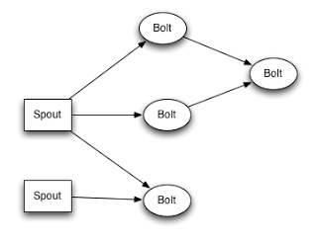
Storm: Real-Time Data Processing

Slide 65
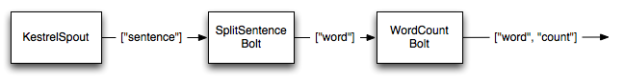
Storm
Provides an abstraction for real-time computation:
Spouts represent (infinite) source of tuples
Bolts consume tuples and emit new tuples
A topology determines how spouts and bolts are connected
Runtime handles:
Process management
Guaranteed message delivery
Fault-tolerance

Slide 66
Hadoop Cluster Architecture
namenode
job submission node
namenode daemon
jobtracker
tasktracker
tasktracker
tasktracker
datanode daemon
datanode daemon
datanode daemon
Linux file system
Linux file system
Linux file system
…
…
…
slave node
slave node
slave node

Slide 67
YARN
Hadoop limitations:
Can only run MapReduce
What if we want to run other distributed frameworks?
YARN = Yet-Another-Resource-Negotiator
Provides API to develop any generic distribution application
Handles scheduling and resource request
MapReduce (MR2) is one such application in YARN

Slide 68
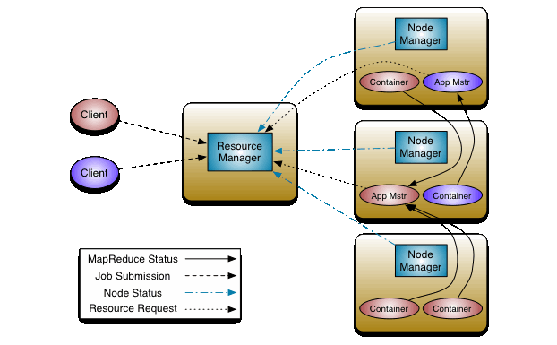
YARN: Architecture

Slide 69
Today’s Agenda
Making Hadoop more efficient
Tweaking the MapReduce programming model
Beyond MapReduce

Slide 70

Questions?
Source: Wikipedia (Japanese rock garden)

